Slide 1




HTML & CSS „The Beginning”
Monika Zamojska
Bartosz Tupta
Notes:
intro BT (10 minut)
html MZ (15 minut)
CSS MZ (12 minut)
CSS Dinner BT (10 minut)
less/sass BT (5 minut)
QUIZ MZ (6 minut)
HTML/CSS possibilites (MZ) (~ 6 minut)
Intro do workshopow MZ (1 minuta)

Slide 2


Slide 3


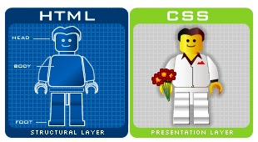
HTML CSS

Slide 4


Slide 5
Doctype
it is an instruction to the web browser about what version of HTML the page is written in
HTML5 <!DOCTYPE html>
HTML 4.01 Strict <!DOCTYPE HTML PUBLIC "-//W3C//DTD HTML 4.01//EN" "http://www.w3.org/TR/html4/strict.dtd">

Slide 6
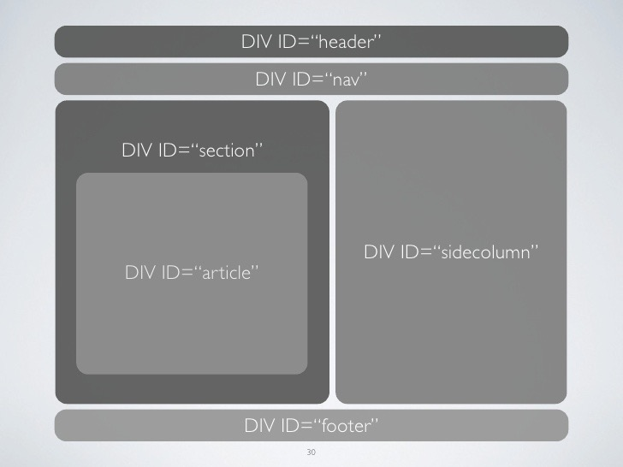

Slide 7
[…] <div id=”header”></div> <div id=”nav”></div> <div id=”section”> <div id=”article”></div> </div> <div id=”sidecolumn”></div> <div id=”footer”></div> […]

Slide 8
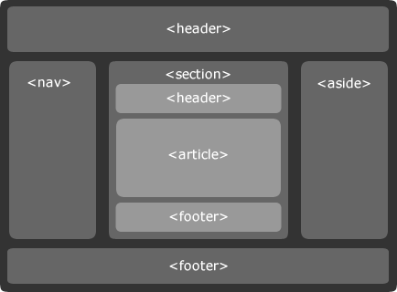

Slide 9
[…] <header></header> <nav></nav> <section> <header></header> <article></article> <footer></footer> </section> <aside></aside> <footer></footer> […]

Slide 10


Slide 11


Slide 12


Slide 13
#xyz { color: red }

Slide 14



Slide 15


Selectors
.className {}
tagName {}
#idName {}
.className.classNameModificator{}
tagName[attr=value] {}
.className:pseudoClass {}
* {}
element > element
… others

Slide 16
Properties
~ 200

Slide 17
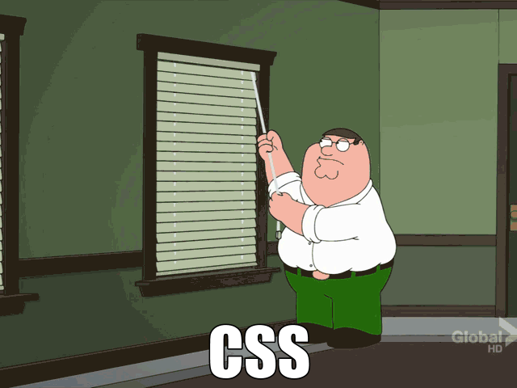

Slide 18
Semantic html
WHY SO IMPORTANT?

Slide 19
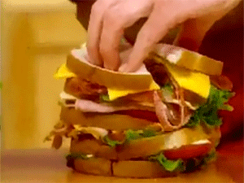

Slide 20



Slide 21
„I feel so guilty adding a div.
Div-itis is terrible, I hear.”
– developer
Notes:
Try to use div only because of styling needs

Slide 22
SEMANTIC REALISM
ACCESSIBILITY
READABLE
Notes:
3 main rules

Slide 23

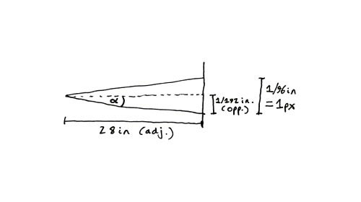
Units
%, em, px, pt, pc, ex, cm, mm, in, rem, vh, vw, vmin, vmax

Slide 24

PX
.

Slide 25
EM
Relative to the font-size of the element (2em means 2 times the size of the current font) (but only font-size)
Useful in Responsive Web Design

Slide 26
EM (example)
body {
font-size:14px;
}
h1 {
font-size:2em;
}
p {
font-size:1.2em;
}
h1 header 28px
and this is a paragraph which is 16px
http://pxtoem.com/

Slide 27


%

Slide 28

The first time you apply a CSS to a web page

Slide 29


LESS / SASS
CSS preprocessors

Slide 30
monika!
IT’s your turn!

Slide 31
CSS Din(n)er

Slide 32
helpers!
Monika
Robert
Tomasz

Slide 33
open it.
http://bit.ly/1oEpqyD
or just http://flukeout.github.io/

Slide 34
time for workshops!
you have 90 minutes
you’ve got our “helpers”
download assets from: http://thewayforward.pl/pinksponge.zip

Slide 35
go!

Slide 36


